Slide 1
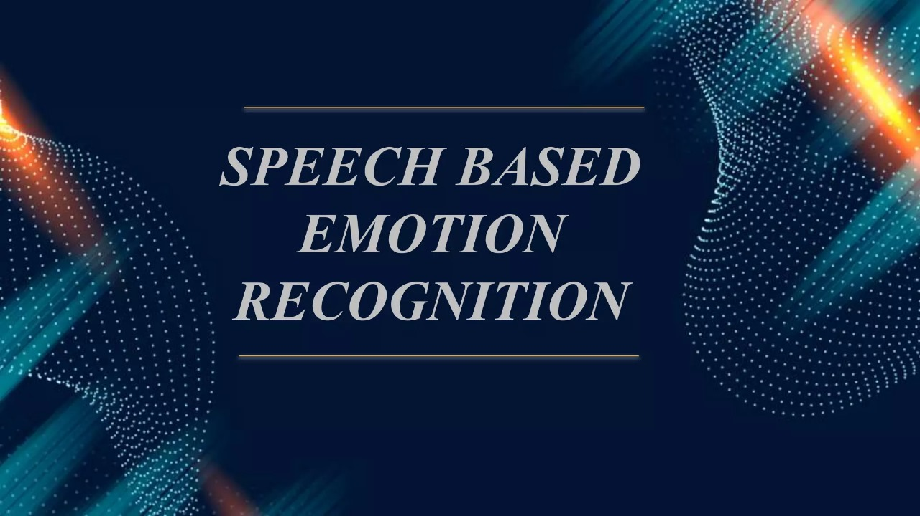
TEAM :
SATISH .CH
ABHINAV .D
LOKESH .P
PARDHU .N
KARTHIKEYA .P

Slide 2
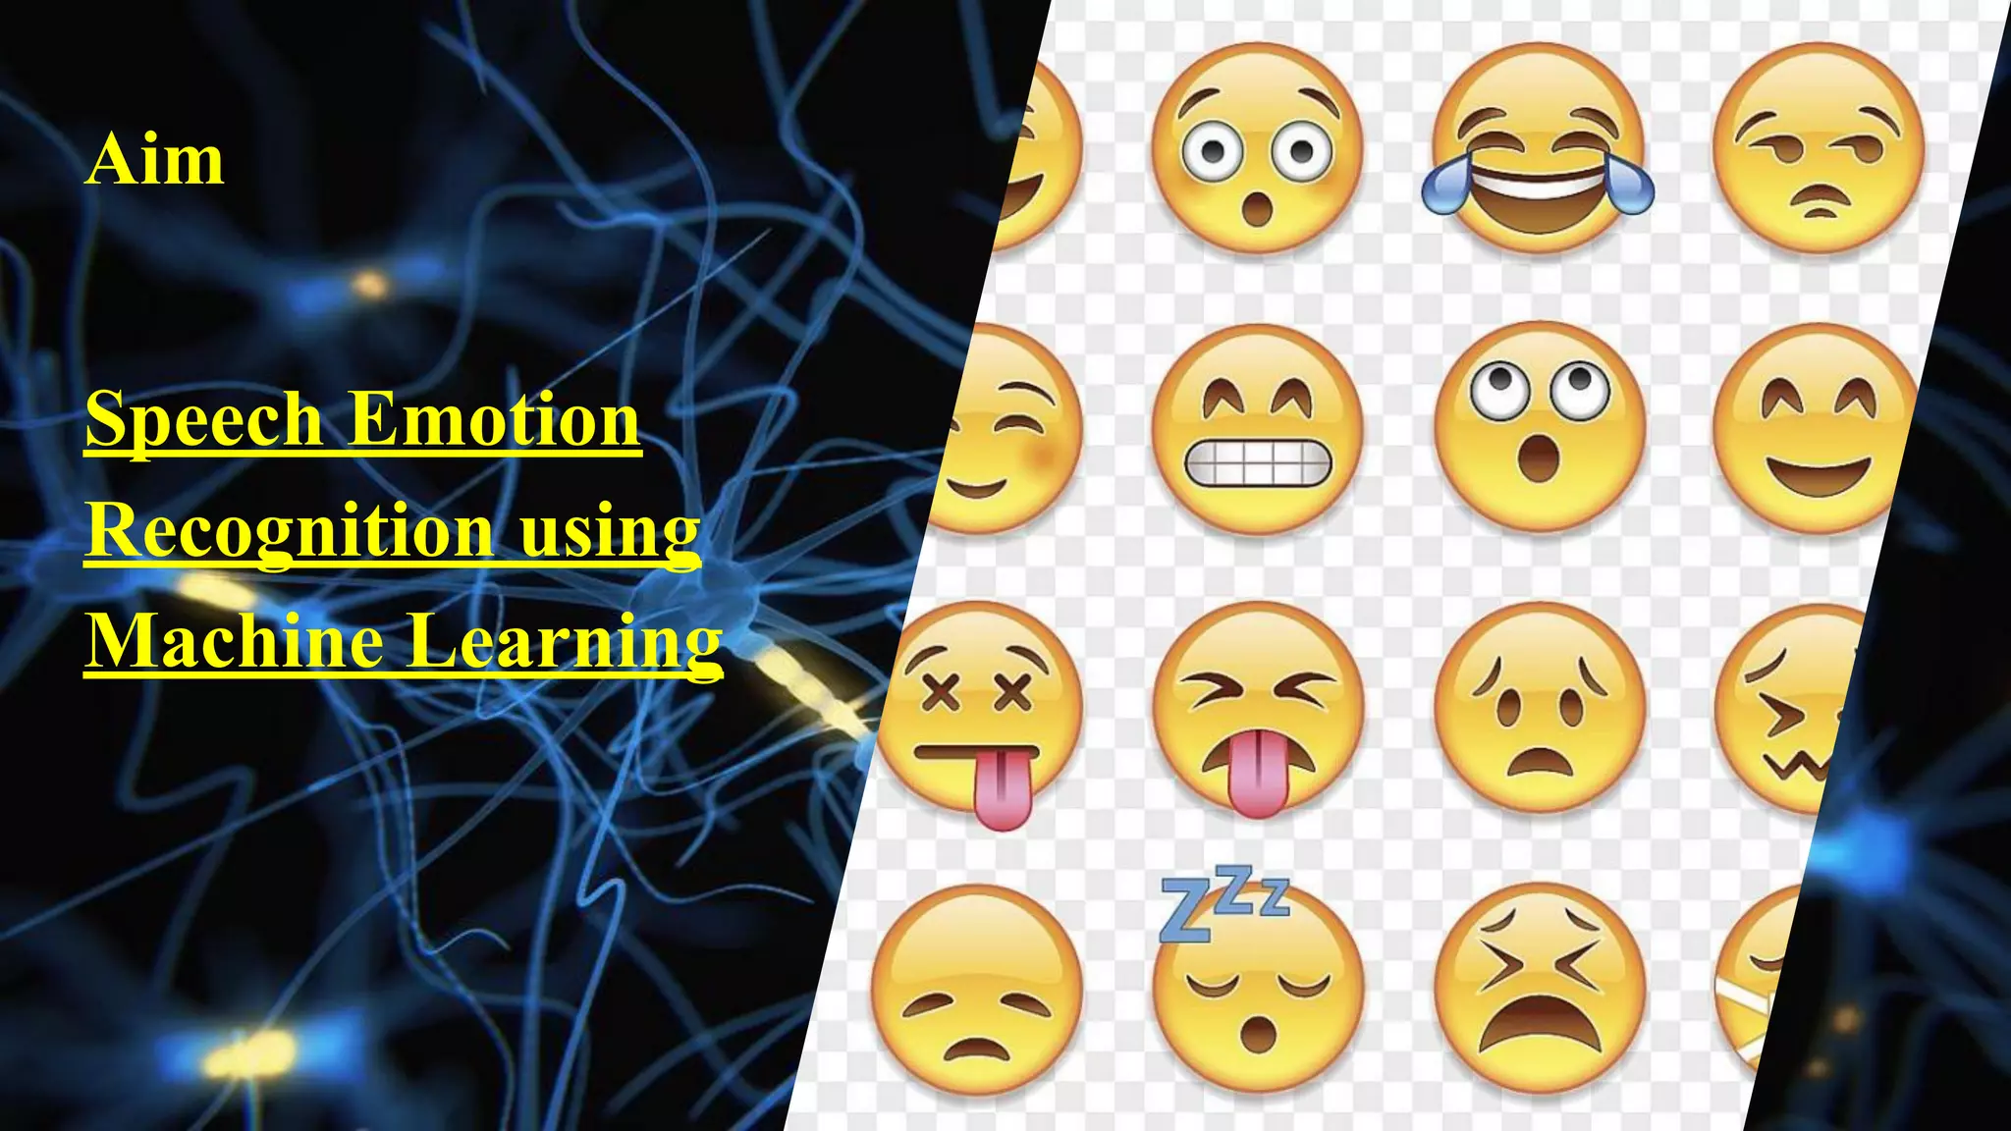

Slide 3

PROBLEM STATEMENT
Speech Emotion Recognition Using LIBROSA and Neural Network Classifier.

Slide 4
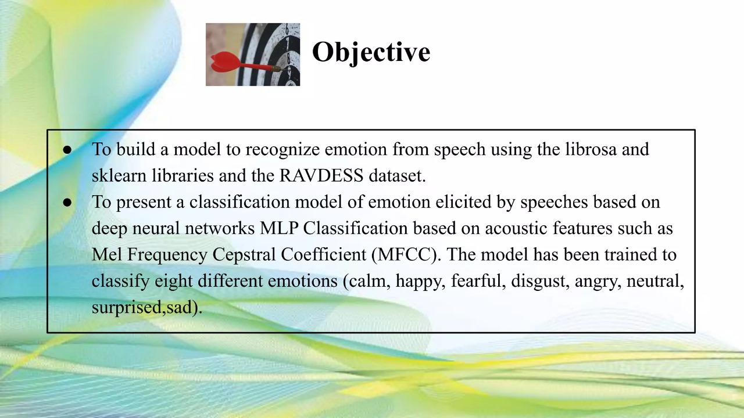

Slide 5
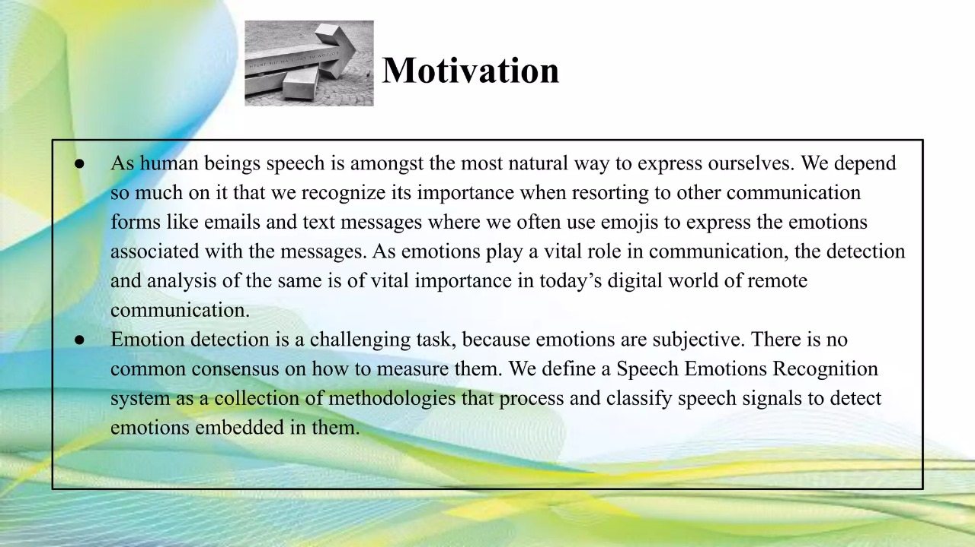

Slide 6
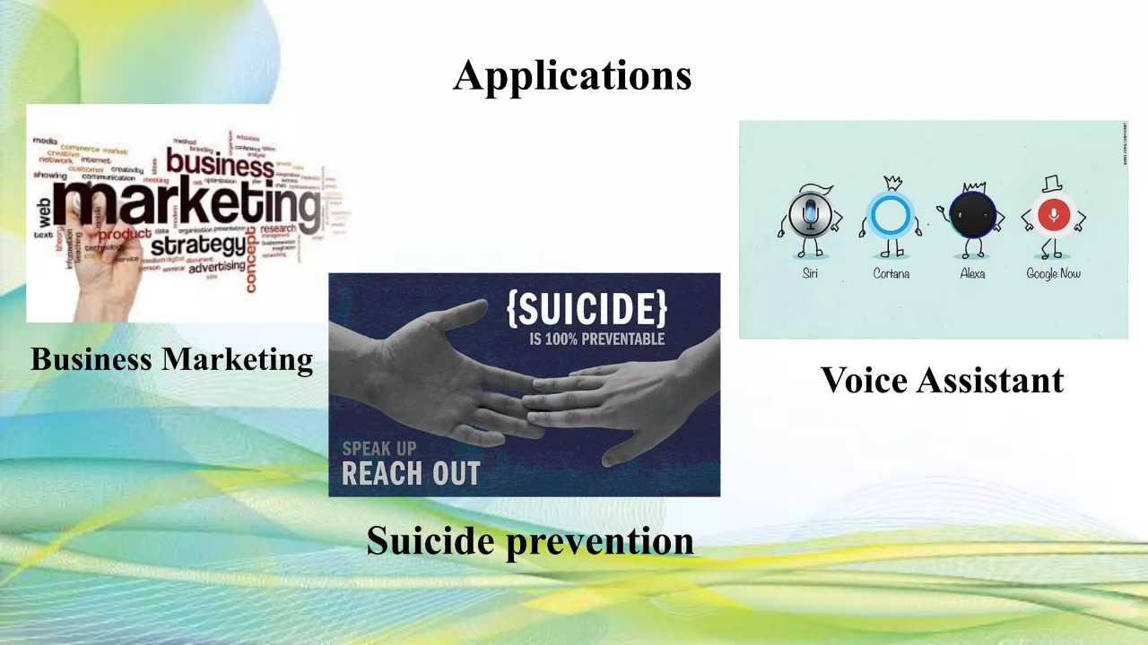

Slide 7
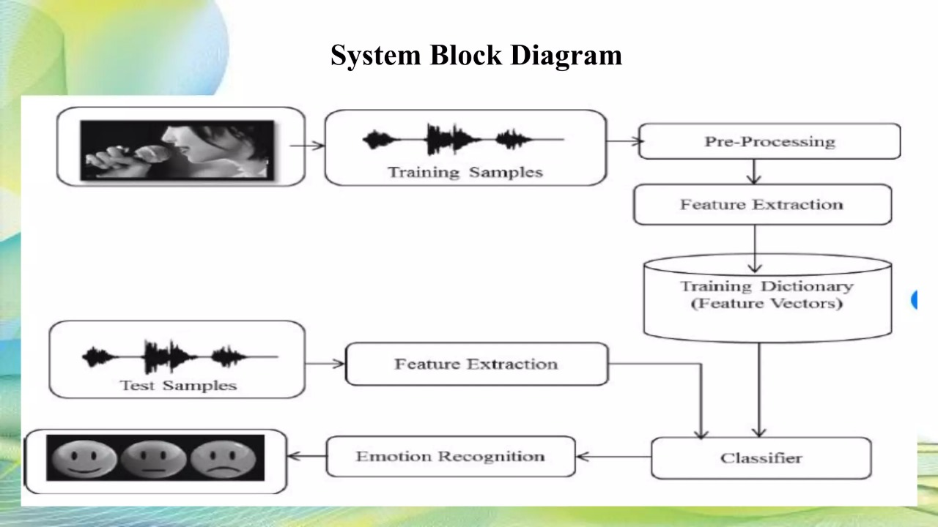

Slide 8
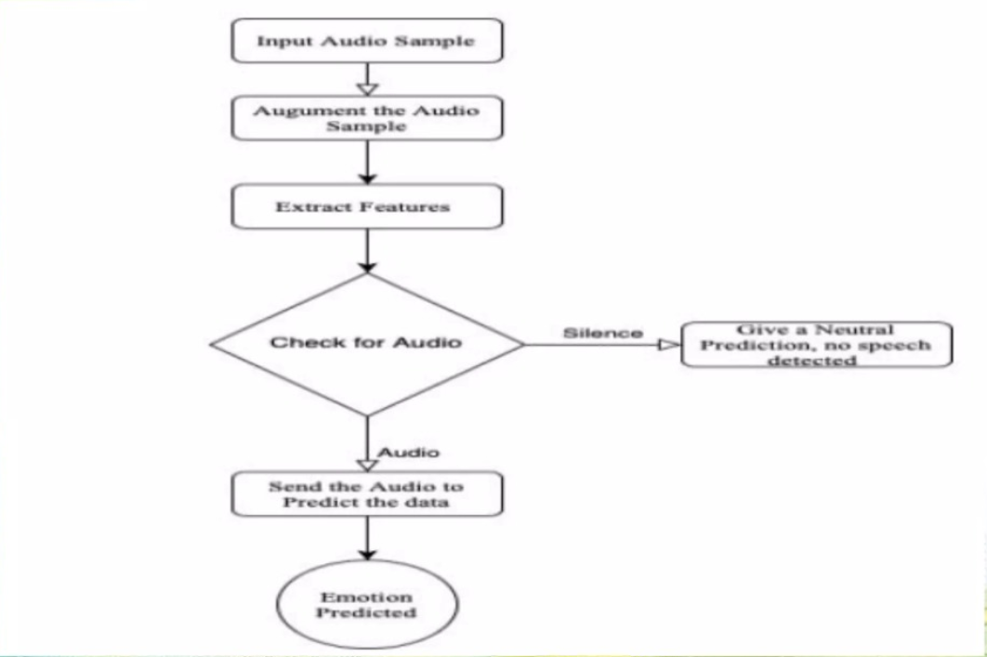
TRAINING PROCESS WORKFLOW

Slide 9
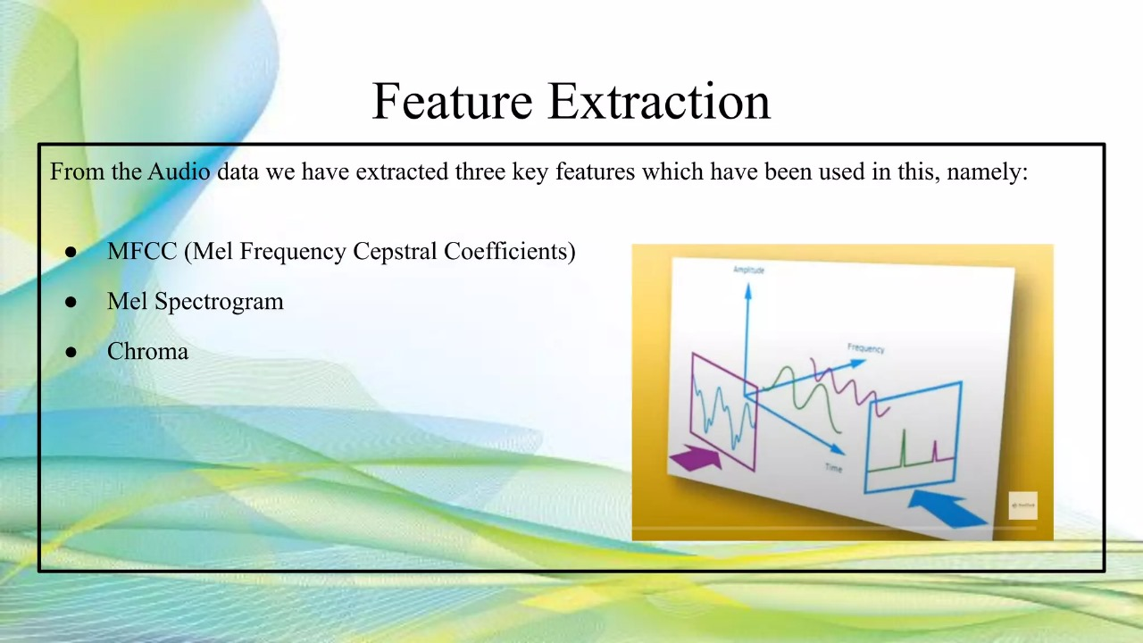

Slide 10
IMPORTANT ELEMENTS
Libraries:
Librosa ,
Soundfile ,
OS, glob, Sklearn ;
Data Sets :
RAVDESS ;
Extracted Features ;
Data Splitting ;
Model Building ;
Accuracy and Classification Tech ;

Slide 11
THANK
YOU

